Slide 1
Koss task
Mohul Dutta – 22EC30035

Slide 2
General stuff we must know before we jump in
Parallel vs synchronous vs asynchronous programming
coroutine function
asyncio package
General stuff about accessing the website using python and downloading things

Slide 3
Synchronous vs asynchronous vs parallel programming
Consider an example u ordered 2 dishes
Let the dish 1 requires 6 minutes of which its divided into 3 minutes +2 minutes + 1 minutes.(where 3 minutes is the initial making process and next 2 minutes is waiting time and last 1 minute is for final touch)
For dish 2 we require 2 minutes .Consider the following 3 ways of serving the customer
Make dish 1 in 6 minutes then dish 2 in 2 minutes ,total time = 8 minutes
Make dish 1 in for 1st 3 minutes then shift to dish 2 and then move back to task 1total time required is 6 minutes
Ask 2 juniors to make the 2 dishes starting at the same time, so time required = 6 minutes

Slide 4
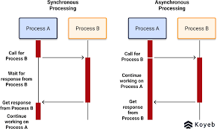
The first type of execution is called synchronous programming
The 2nd type is asynchronous programming
The 3rd type is parallel programming

Slide 5
Synchronous programming
Definition: Synchronous programming executes tasks sequentially, one after another. Each task must complete before the next one starts.
Examples:
Writing a script that reads a file line by line and processes each line before moving to the next one.
Calling a function and waiting for its return value before executing the next line of code.

Slide 6
Asynchronous programming
Definition: Asynchronous programming allows tasks to run concurrently and independently. Tasks can start, pause, and resume without blocking the execution of other tasks.
Examples:
Making multiple HTTP requests to different endpoints and processing the responses as they arrive, without waiting for each request to complete.
Using callbacks or promises to handle events and execute code when specific actions occur, such as user interactions or data availability.

Slide 7
Parallel programming
Parallel programming involves executing multiple tasks simultaneously across multiple processors or threads to achieve performance improvement by dividing the workload. It aims to exploit the available hardware resources efficiently to speed up the execution of compute-bound tasks. Unlike sequential or synchronous programming, parallel programming allows tasks to be executed concurrently, maximizing resource utilization.
Examples of parallel programming include running simulations on multiple CPU cores, processing large datasets using distributed computing frameworks like Apache Spark, and utilizing GPU parallelism for accelerating graphics rendering or machine learning computations.

Slide 8
Parallel programming differs from multiprocessing programming in that it focuses on breaking down a task into smaller subtasks that can be executed simultaneously. It typically involves coordinating and synchronizing these subtasks to ensure correctness and data integrity. Multiprocessing, on the other hand, involves using multiple processes to execute tasks, each with its own memory space, while parallel programming can involve threads within a single process.
Python's Global Interpreter Lock (GIL) is a mechanism that ensures only one thread executes Python bytecode at a time, which limits true parallelism in Python for CPU-bound tasks. However, Python can still achieve parallelism through various means, such as multiprocessing, where multiple processes can execute in parallel, or by utilizing external libraries like asyncio that leverage low-level optimizations and parallel execution under the hood.

Slide 9
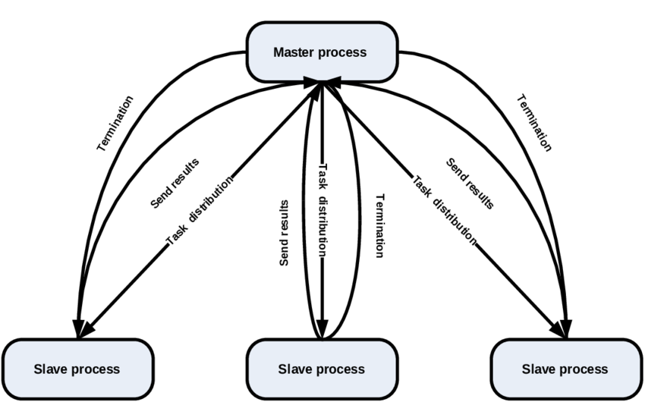

Slide 10
Asyncio
The asyncio package in Python provides an asynchronous programming framework that allows efficient and concurrent execution of I/O-bound tasks. It is particularly well-suited for network-related operations, such as accessing websites and downloading content.
Using the aiohttp library, which is built on top of asyncio, you can easily make HTTP requests and handle responses asynchronously. This enables you to perform multiple web requests concurrently, improving performance and responsiveness.
To download content from a website, you can use the aiohttp.ClientSession to create an HTTP session and issue GET requests. The responses can be processed asynchronously to retrieve data, such as HTML, JSON, or binary files. You can then save the downloaded content to local files or process it further as needed.
Overall, asyncio and aiohttp provide powerful tools for efficient web scraping, API integration, and downloading data from websites, making it easier to work with asynchronous I/O tasks in Python.

Slide 11
Task 1 –synchronous execution (org. code)
import asyncio → importing asyncio package
import time →importing the time package used in time.time() async def sleep_coro(duration): →it’s a coroutine function,
await asyncio.sleep(duration) → to pause the coroutine for a few minutes async def main(): → exection starts from here
obj1 = sleep_coro(1) →three we hv defined 3 asynchronous objects
obj2 = sleep_coro(2) → here 1,2,3 are in seconds and basically are the duration in which it pauses
obj3 = sleep_coro(3)
# See that the three objects would execute synchronously,
# so it will take 1 + 2 + 3 seconds to execute.
start = time.time() → tells no. of second since 1 jan 1970 and tells time of execution await obj1
await obj2 → waits for 1+2+3
await obj3 time_taken = time.time() – start →time of execution
print('Time Taken {0}'.format(time_taken))
# Call asyncio.run(main()) outside of any existing event loop
asyncio.run(main())

Slide 12
Parallelizing task 1
import asyncio
import time
async def sleep_coro(duration):
await asyncio.sleep(duration)
async def main():
obj1 = sleep_coro(1)
obj2 = sleep_coro(2)
obj3 = sleep_coro(3)
start = time.time()
await asyncio.gather(obj1, obj2, obj3) → this statement makes them execute synchronusly
time_taken = time.time() - start
print('Time Taken {0}'.format(time_taken))
asyncio.run(main())

Slide 13
Downloading a webpage-in html and saving the file
We should write a code that synchronously downloads all the 3 HTML files and thereby saves time. So that’s always a improvement in the execution time.
To pull this off we use aiohttp for accessing and retrieving data from server , we also download the files at some location.

Slide 14
Task 2 – downloading webpage- html
import aiohttp
import asyncio
import time as t
import os
async def download_page(el):
url = f"https://reqres.in/api/users?page{el}" →getting the new link after changing el
async with aiohttp.ClientSession() as session:
async with session.get(url) as response:
data = await response.text() →retrieving data in html
return data
async def main():
arr = [1, 2, 3]
tasks = []

Slide 15
folder_path = r"C:\Users\MOHUL DUTTA\Desktop\json files download" start=t.time()
for el in arr:
task = asyncio.create_task(download_page(el))
tasks.append(task)
results = await asyncio.gather(*tasks)
for i, result in enumerate(results, start=1):
filename = os.path.join(folder_path, f"page_{i}.html") # Specify the filename pattern with .html extension
with open(filename, 'w') as file:
file.write(result)
print(t.time()-start)
asyncio.run(main())
Time required is around 0.22 seconds

Slide 16
Synchronously downloading 200 json files
import requests
import os
import re
import time as t
def sanitize_filename(filename):
# Remove invalid characters from the filename
sanitized_filename = re.sub(r'[<>:"/\\|?*]', '', filename)
return sanitized_filename
def download_page(comic_id):
url = f"https://xkcd.com/{comic_id}/info.0.json"
response = requests.get(url) →getting the response

Slide 17
data = response.json() →getting json file
title = data['title']
sanitized_title = sanitize_filename(title)
folder_path = r"C:\Users\MOHUL DUTTA\Desktop\synch download of json" # Specify the folder path
filename = os.path.join(folder_path, f"{sanitized_title}.json")
with open(filename, 'w') as file:
file.write(str(data))
def main():
start=t.time()
for comic_id in range(1, 201):
download_page(comic_id)
print(t.time()-start)
main()

Slide 18
Parallise the download and saving the files in a folder

Slide 19
import aiohttp
import asyncio
import os
import time as t
import re
def sanitize_filename(filename):
# Remove invalid characters from the filename
sanitized_filename = re.sub(r'[<>:"/\\|?*]', '', filename)
return sanitized_filename
async def download_page(comic_id):
url = f"https://xkcd.com/{comic_id}/info.0.json"
async with aiohttp.ClientSession() as session:
async with session.get(url) as response:
data = await response.json()
title = data['title']
sanitized_title = sanitize_filename(title)

Slide 20
folder_path = r"C:\Users\MOHUL DUTTA\Desktop\json files download"
filename = os.path.join(folder_path, f"{sanitized_title}.json")
with open(filename, 'w') as file:
file.write(str(data))
async def main():
tasks = []
start = t.time()
for comic_id in range(1, 201):
task = asyncio.create_task(download_page(comic_id))
tasks.append(task)
await asyncio.gather(*tasks)
print(t.time() - start)
asyncio.run(main())

Slide 21
Exaplanation of the code
The code uses the aiohttp library for making asynchronous HTTP requests and asyncio for trying to synchronise the executions.
The download_page function is defined as an asynchronous function. It takes a comic_id parameter and constructs a URL to download a JSON file from the XKCD website.
Within the download_page function, an aiohttp.ClientSession is created using the async with statement. This session manages the underlying TCP connection and provides methods for making HTTP requests.
A GET request is made to the specified URL using the session.get method. The response is captured using the async with statement to ensure proper handling and closing of the response object.
The JSON data from the response is extracted using the response.json() method, and the title of the comic is obtained from the data.
The folder path where the JSON files will be saved is specified using the folder_path variable.

Slide 22
The os.path.join function is used to create the complete file path by combining the folder path and the filename (based on the comic title).
The JSON data is written to the file using the open function in write mode ('w'). The str function is used to convert the JSON data to a string before writing.
The main function is defined to orchestrate the downloading of multiple comic pages. It creates a list of tasks, where each task represents the execution of the download_page function for a specific comic ID.
The asyncio.gather function is used to concurrently execute all the tasks. It waits for all tasks to complete before proceeding.
The asyncio.run function is called to run the main function and start the asyncio event loop.
Each statement in the code serves a specific purpose, such as setting up the HTTP client session, making HTTP requests, handling the response, extracting data, creating file paths, writing data to files, and managing concurrent execution using asyncio.
asyncio.gather(): This function takes in multiple awaitable objects (in this case, the tasks list) and schedules them to run concurrently in the event loop. It returns a future that represents the collective result of all the awaitable objects.

Slide 23
Some lines to comment on…
In the line url=f”….” we are using Formatted string ,so that we can use the website we want of necessary number.
The line async with aiohttp.ClientSession() as session: is using an asynchronous context manager to create a ClientSession object from the aiohttp library.
The async with statement is used to define an asynchronous context. It ensures that any resources acquired within the context are properly managed and cleaned up when they are no longer needed. It is similar to the with statement used for synchronous context management but designed for use with asynchronous code.
aiohttp.ClientSession is a class provided by the aiohttp library that represents a connection session for making HTTP requests. It manages the underlying TCP connection and provides methods for making requests such as GET, POST, etc. Creating an instance of ClientSession allows you to reuse the same connection for multiple requests, which can improve efficiency.

Slide 24
as session: The as session part of the line assigns the created ClientSession object to the variable name session. This allows you to reference and use the session object within the context. By using async with aiohttp.ClientSession() as session:, you create a ClientSession object named session within an asynchronous context. The context manager ensures that the session is properly handled, including closing the underlying connection, when you are done with it. This allows you to make HTTP requests using the session object in an efficient and managed manner.
The async with session.get(url) as response line is used to make an asynchronous GET request to the specified url using the client session session. It captures the response from the request and assigns it to the response variable within the scope of the async with block. The async with block ensures that the acquired resources, such as the connection and response, are properly managed and closed when they are no longer needed, regardless of whether an exception occurs or not.
The line data = await response.json() is used to asynchronously retrieve the response body as JSON data from the HTTP response object response. The await keyword is used to pause the execution of the coroutine until the JSON data is available. Once the JSON data is obtained, it is assigned to the variable data.

Slide 25
The response.json() method is an asynchronous method provided by the aiohttp library, and it parses the response body as JSON data. By using await, we can await the completion of this asynchronous operation and obtain the JSON data to further process or use in our program.
The line task = asyncio.create_task(download_page(comic_id)) creates a task using the asyncio.create_task() function.In this case, the task is created to execute the download_page(comic_id) coroutine function. The download_page() function is passed the value of comic_id, which represents an element from the arr list.Creating a task allows us to run the download_page() coroutine concurrently with other tasks. The create_task() function schedules the execution of the coroutine in the event loop and returns a task object representing that execution. This task can then be awaited or managed independently.By creating a task, we enable concurrent execution of multiple coroutines, allowing them to progress concurrently and potentially improve the overall efficiency of the program.
asyncio.gather(): This function takes in multiple awaitable objects (in this case, the tasks list) and schedules them to run concurrently in the event loop. It returns a future that represents the collective result of all the awaitable objects.
The reason why we used the sanitsed function as we have to ensure that we don’t have characters like ? Which were creating a problem

Slide 26
The difference in time of this and synchronous programming
For asynchronous programming time required is 1.34718656539917 seconds
For synchronous programming it varies around 42 seconds to 55 seconds
In general it comes around 45 seconds.
This just shows how fast the execution be if we paralellise the code

Slide 27
The end

